Slide 1
Module 4 preventive maintenance and troubleshooting
GELIL DAVID S. GALANG
Instructor I

Slide 2
What is Preventive Maintenance?
is the regular and routine maintenance of equipment and assets in order to keep them running and prevent any costly unplanned downtime from unexpected equipment failure.

Slide 3
What are the types of Preventive Maintenance?
Mandatory / Non-Mandatory Tasks
Mandatory tasks are those that must be performed as soon as they are due and will often include safety-critical checks. Non-mandatory tasks are still important, but can be delayed without resulting in a critical failure or performance reduction.

Slide 4
What are the types of Preventive Maintenance?
Pyramiding / Non-Pyramiding Tasks
Pyramiding tasks occur when maintenance is set for a due date but is not completed and overlaps with a later scheduled maintenance. In this instance, should a new PM task become due, the previous one is cancelled.

Slide 5
What are the types of Preventive Maintenance?
Inspection and Task Oriented Tasks
Inspection tasks require checks to be made before the results are turned into work orders for planned maintenance to fix any problems that have been discovered.

Slide 6
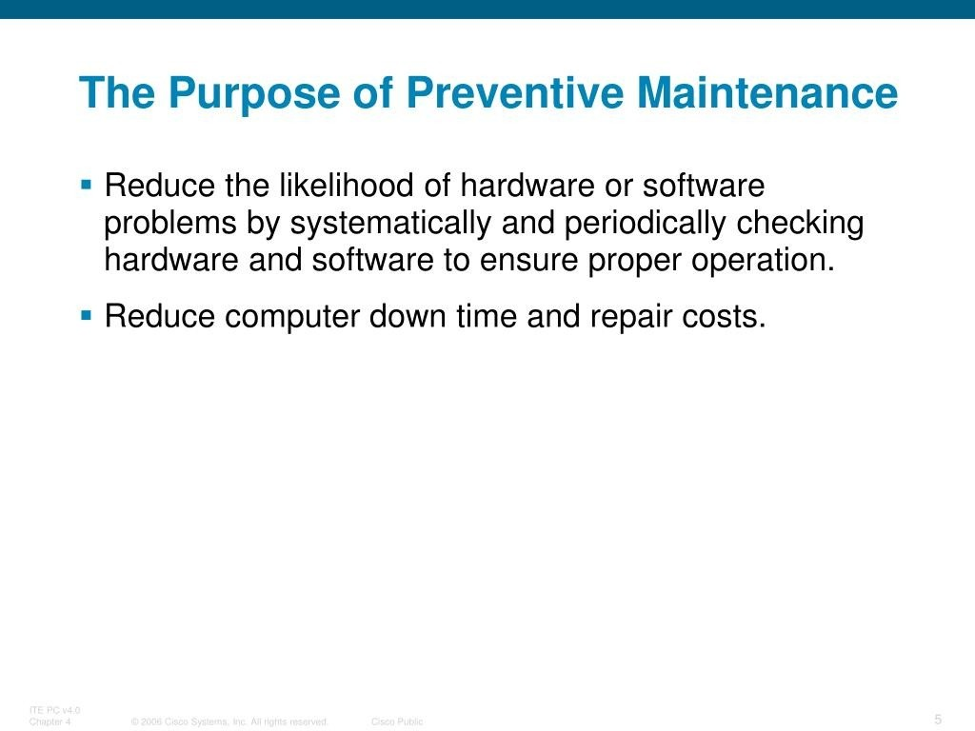
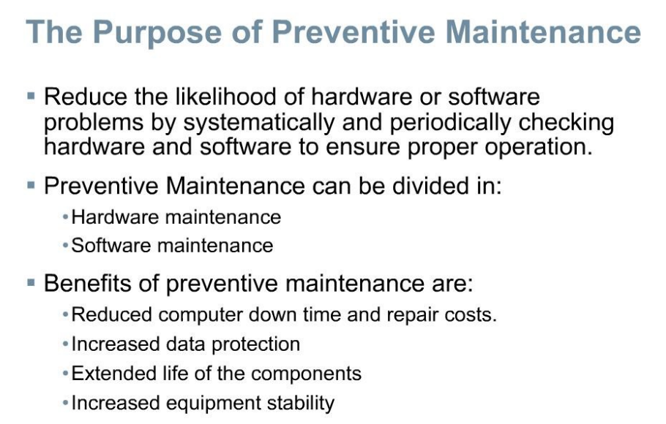

Slide 7
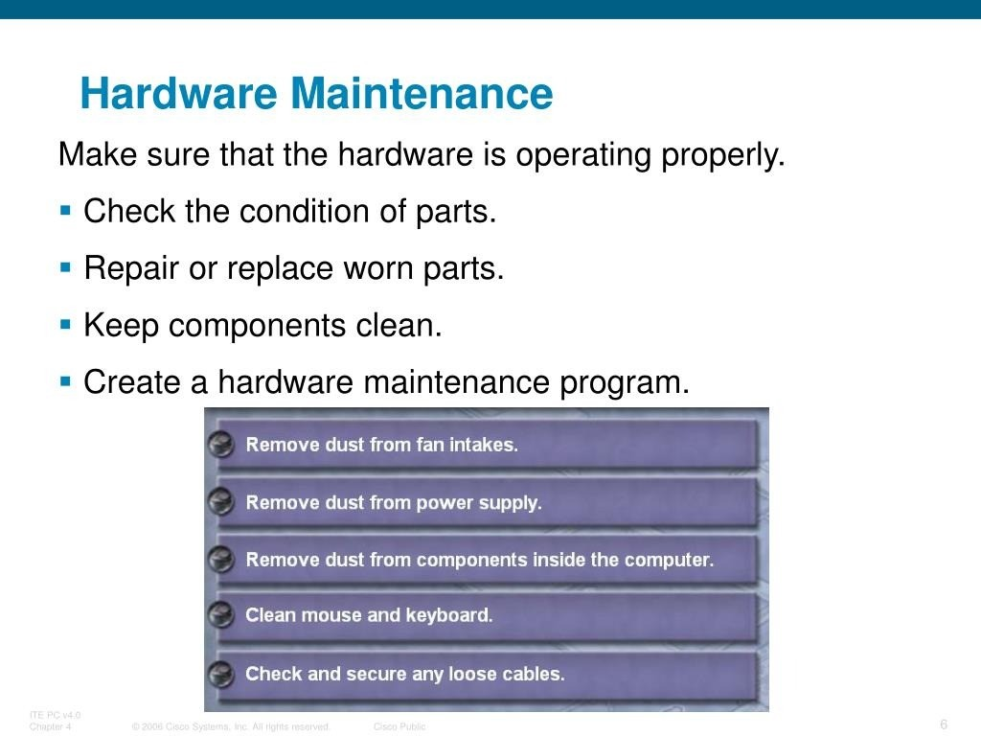

Slide 8
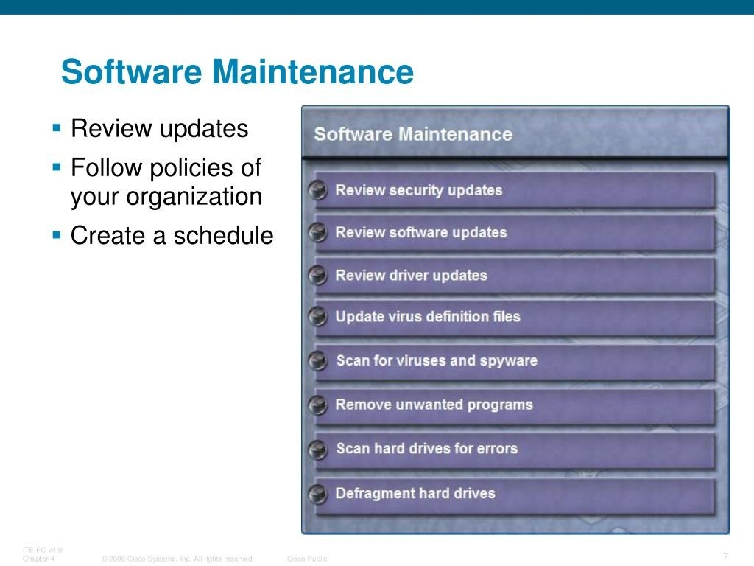

Slide 9
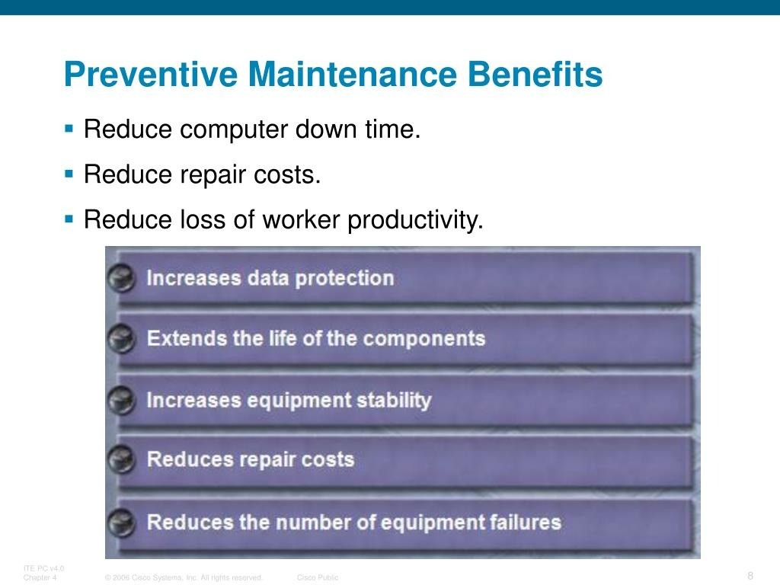

Slide 10

What is Troubleshooting?
is a systematic approach to solving a problem.
The goal of troubleshooting is to determine why something does not work as expected and explain how to resolve the problem.

Slide 11
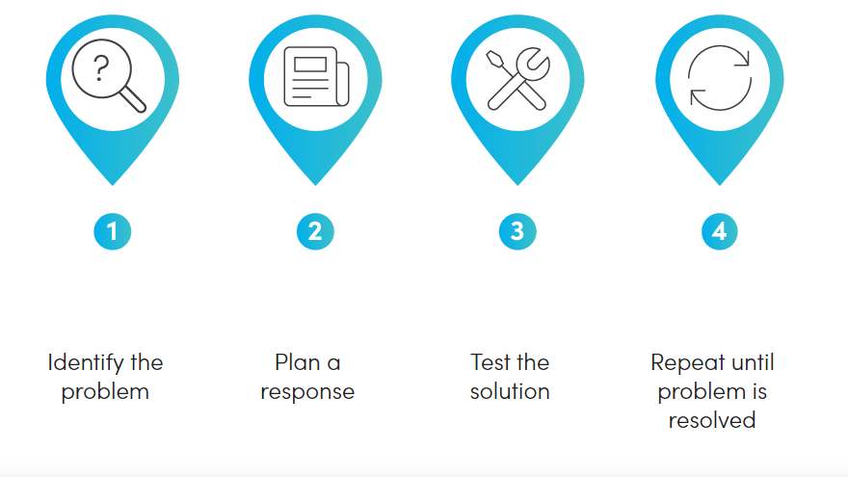
Steps in Troubleshooting.

Slide 12
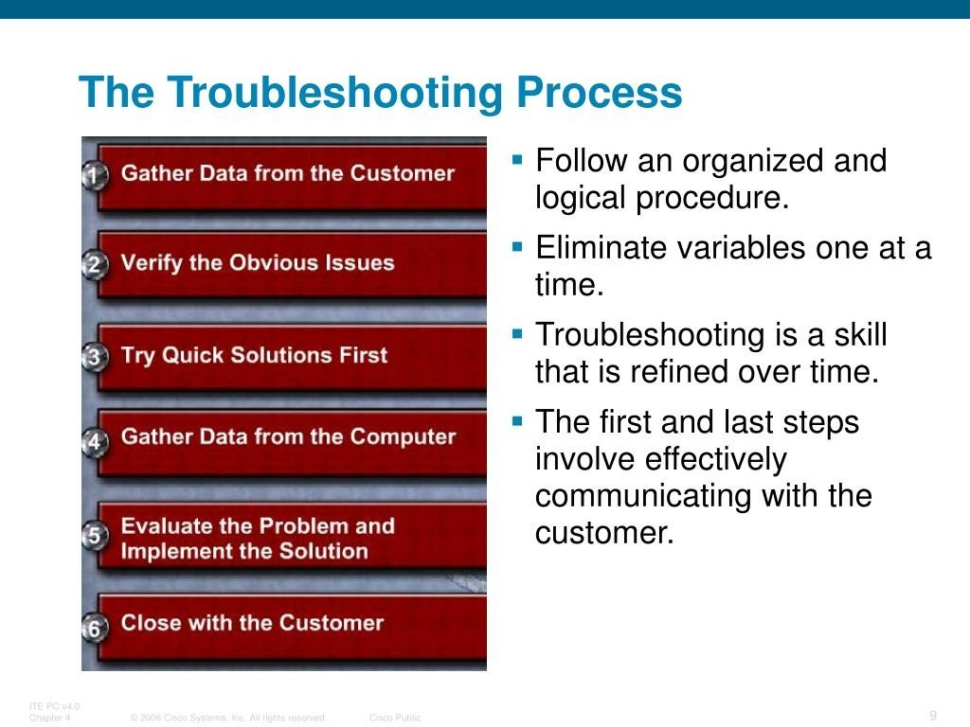

Slide 13
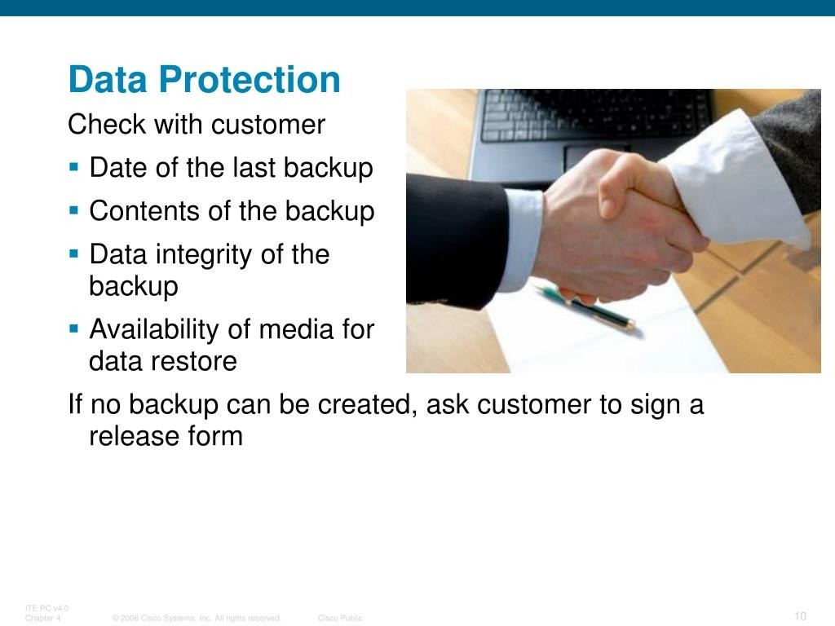

Slide 14
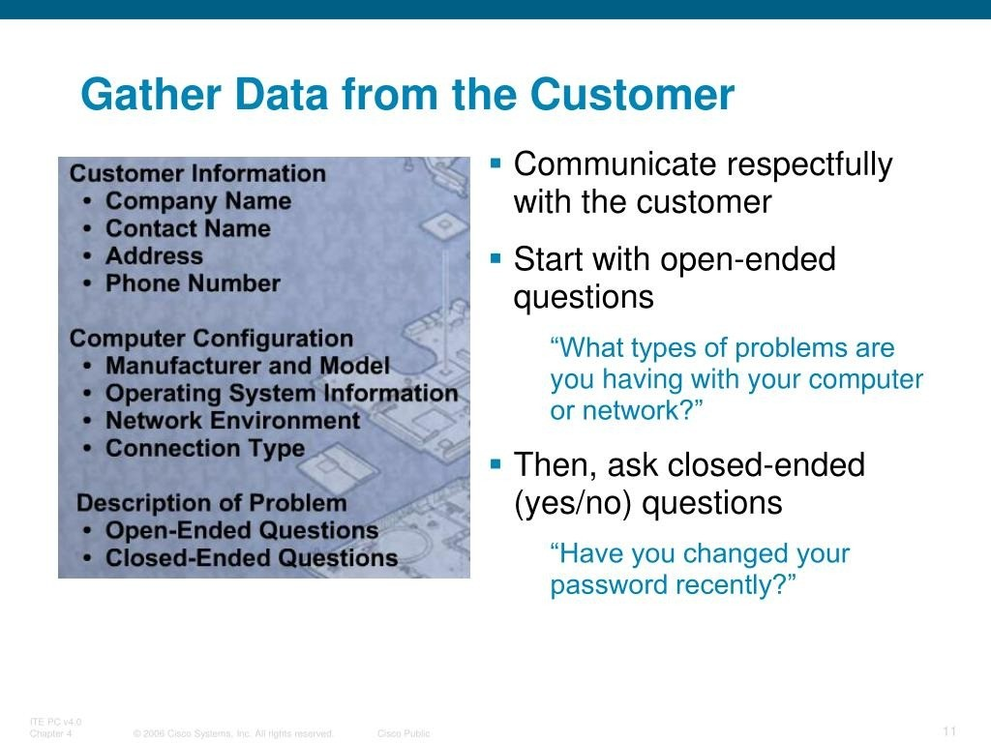

Slide 15
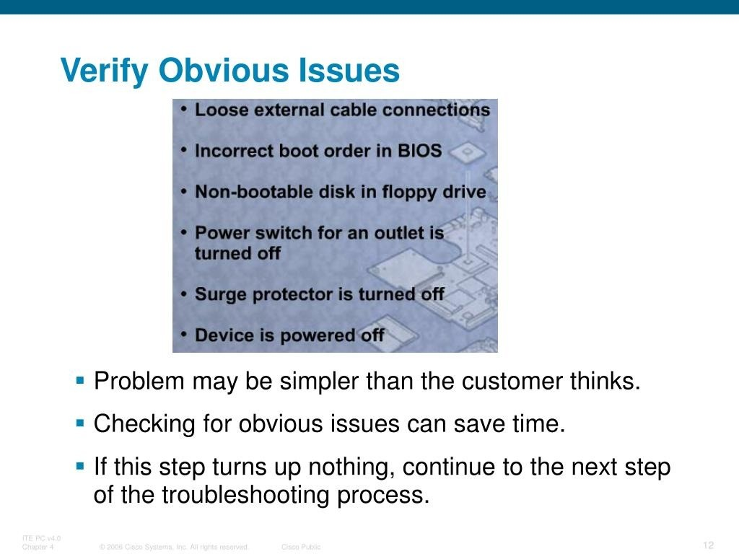

Slide 16
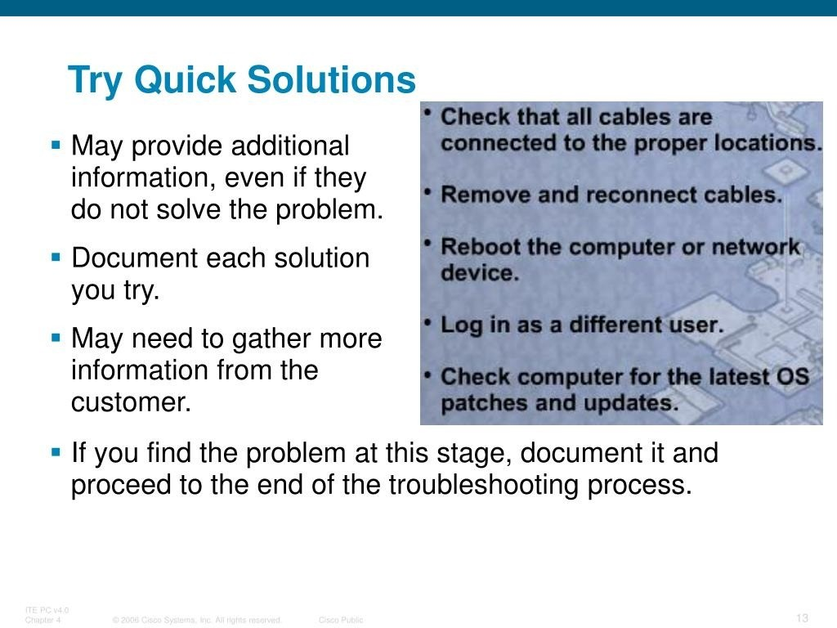

Slide 17
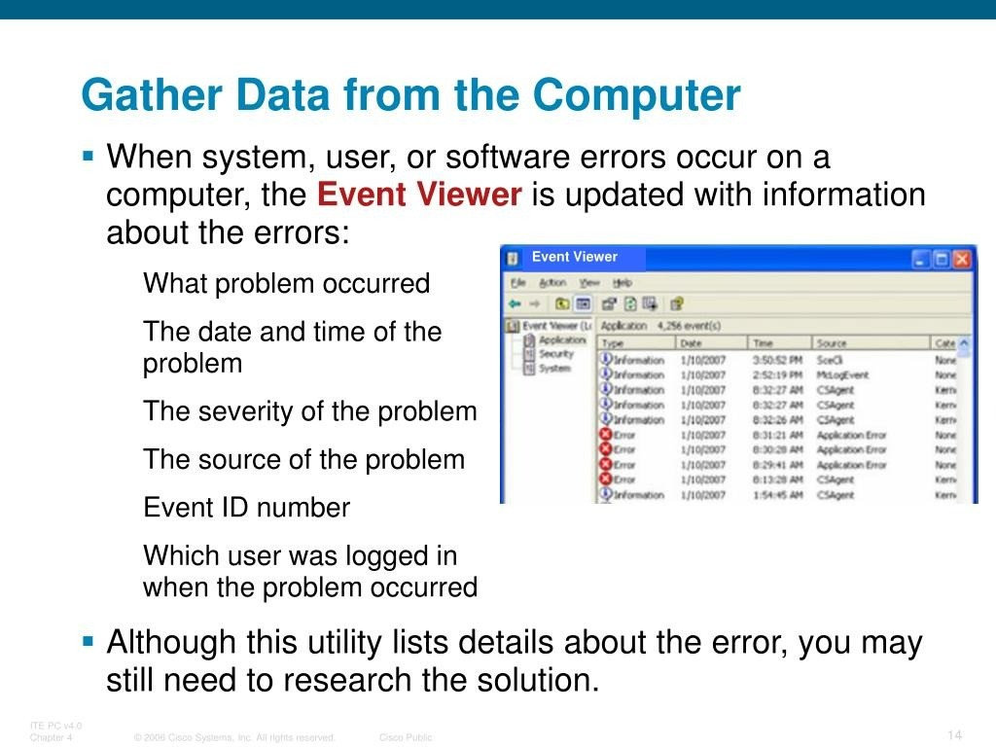

Slide 18
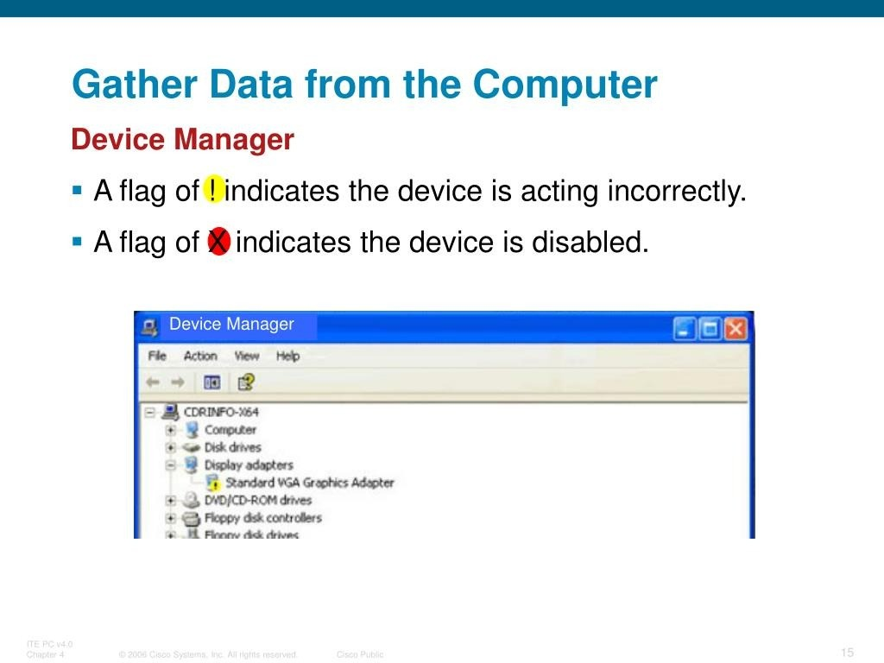

Slide 19
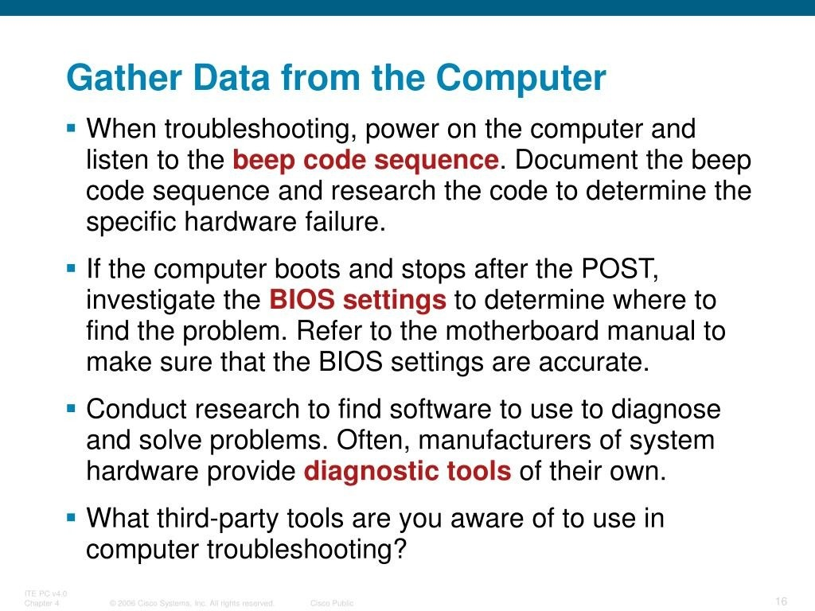

Slide 20
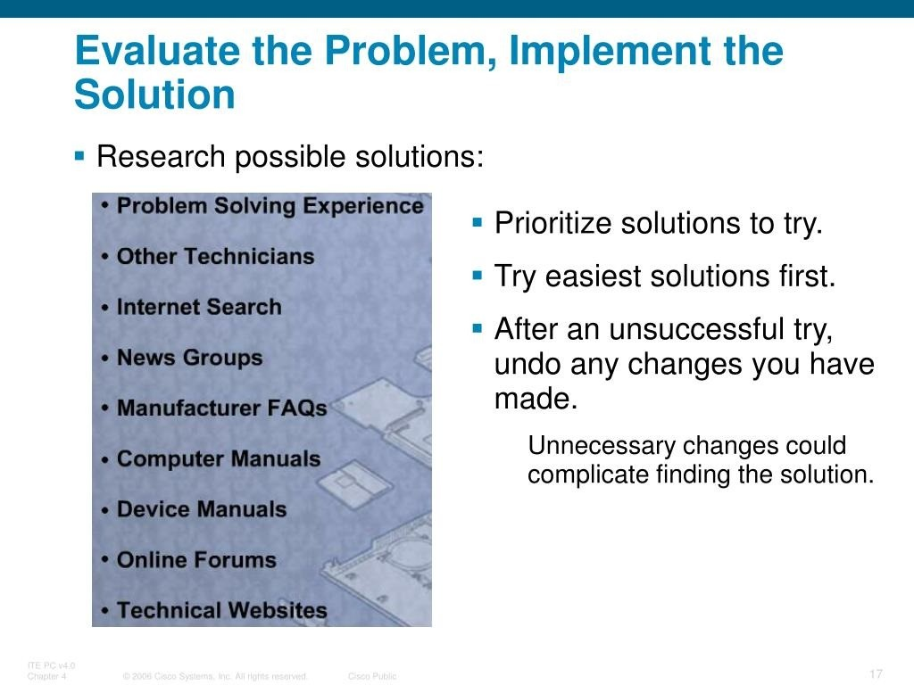

Slide 21
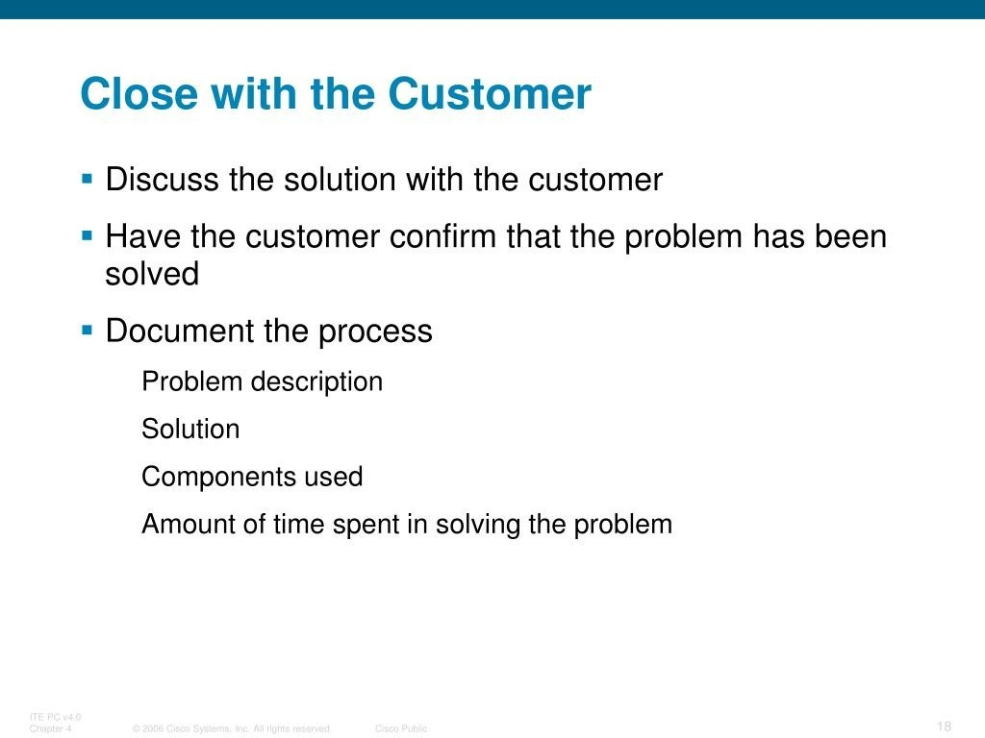

Slide 22
